Slide 1
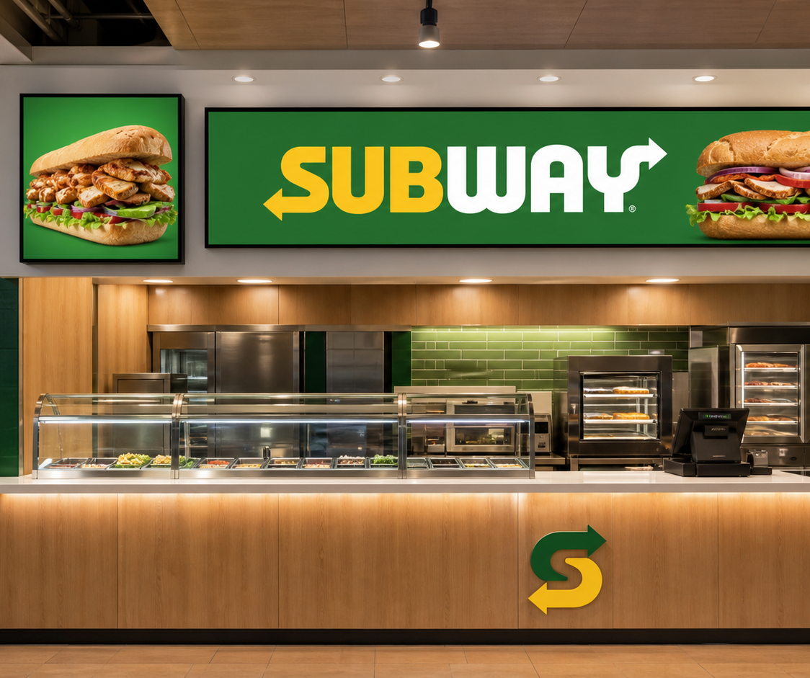
SUB
WAY
Digital screen concepts
Two purpose-built canvases for appetite, identity, and motion at Subway Kings Plaza.
CUSTOMER CONCEPT PRESENTATION
Prepared by VALUEFLUX
Notes:
[Sources]
- OpenAI-generated store installation concept, created 2026-08-14 for SQ-1282.
- Subway marks are shown symbolically for customer concept visualization; final deployment requires Subway-approved brand assets.

Slide 2
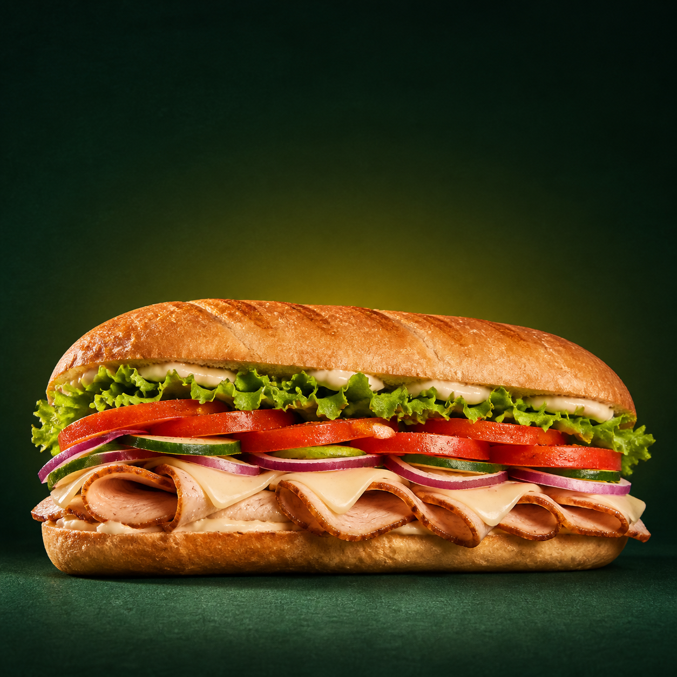
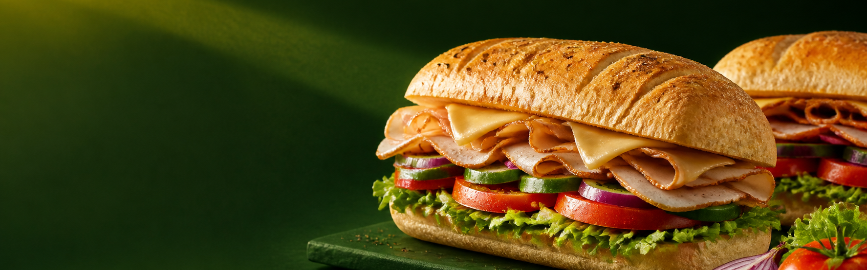
DISPLAY STRATEGY
Two screens, two distinct jobs
SUB
WAY
SUB
WAY
1500 × 500 mm
BRAND + MOTION BANNER
1500 × 1500 mm
The physical canvas stays the same in P1.25 and P1.56; only pixel density and resolution change.
FLAGSHIP HERO CANVAS
SQ-RTX-1282-20260815 • Restaurex • Subway, Kings Plaza
2 / 6
Notes:
[Sources]
- SQ-1282 approved screen sizes from the internal session record.
- OpenAI-generated square and banner food visuals, created 2026-08-14 for SQ-1282.

Slide 3
SQUARE DISPLAY
Make the product the hero
SUB
WAY
Flagship campaign art
Use one bold sandwich, restrained copy, and a clean brand field.
Seasonal launches
Swap hero imagery without changing the physical screen or cabinet matrix.
Distance-first design
Favor large type, one focal product, and strong color contrast for mall traffic.
Best for: signature subs • campaign moments • premium food photography
Notes:
[Sources]
- OpenAI-generated square food hero, created 2026-08-14 for SQ-1282.
- Content recommendations are VALUEFLUX presentation guidance, not official Subway brand standards.

Slide 4
BANNER DISPLAY
Use the wide canvas for brand and appetite in motion
SUB
WAY
FRESHLY MADE
VISUAL ENERGY
1500 × 500 mm • 3:1 native content canvas
Still imagery
Short video
Campaign swap
Wordmark + featured sub
Ingredient motion + reveal
Seasonal art + offer copy
SQ-RTX-1282-20260815 • Restaurex • Subway, Kings Plaza
4 / 6
Notes:
[Sources]
- OpenAI-generated ultrawide food visual, created 2026-08-14 for SQ-1282.
- Subway wordmark treatment is symbolic; use approved master artwork for production.

Slide 5
COORDINATED PLAYBACK
One customer journey across both screens
01
ATTRACT
02
IDENTIFY
03
CONVERT
Square
Banner
Together
A bold product hero catches attention from the mall corridor.
The Subway wordmark establishes the storefront immediately.
Food motion and campaign copy reinforce the featured choice at the counter.
Suggested silent loop
0–3 sec
3–7 sec
7–10 sec
Repeat
Logo arrival
Ingredient motion
Product reveal
Seamless loop
SQ-RTX-1282-20260815 • Restaurex • Subway, Kings Plaza
5 / 6
Notes:
[Sources]
- Playback sequence and timing are VALUEFLUX concept recommendations for a silent in-store LED loop.

Slide 6
CONTENT RECOMMENDATION
Build one campaign system, then scale the playlist
SQUARE • 1500 × 1500
BANNER • 1500 × 500
01 Signature sub hero
02 Seasonal campaign hero
03 Ingredient or craft close-up
01 Subway wordmark lockup
02 Savory sub photography
03 Short silent motion sequence
Keep each composition simple: one product, one message, one unmistakable focal point.
Design natively at 3:1 so the wordmark, food, and motion stay readable without awkward cropping.
Next step
Replace concept imagery with Subway-approved campaign assets and export final content at the selected pitch resolution.
VALUEFLUX • Pixels, Pulse, Purpose
6 / 6
Notes:
[Sources]
- SQ-1282 screen dimensions and selected X-Series COB product scope.
- Final public-facing creative requires Subway-approved artwork, product claims, offers, and brand governance.

